Slide 1


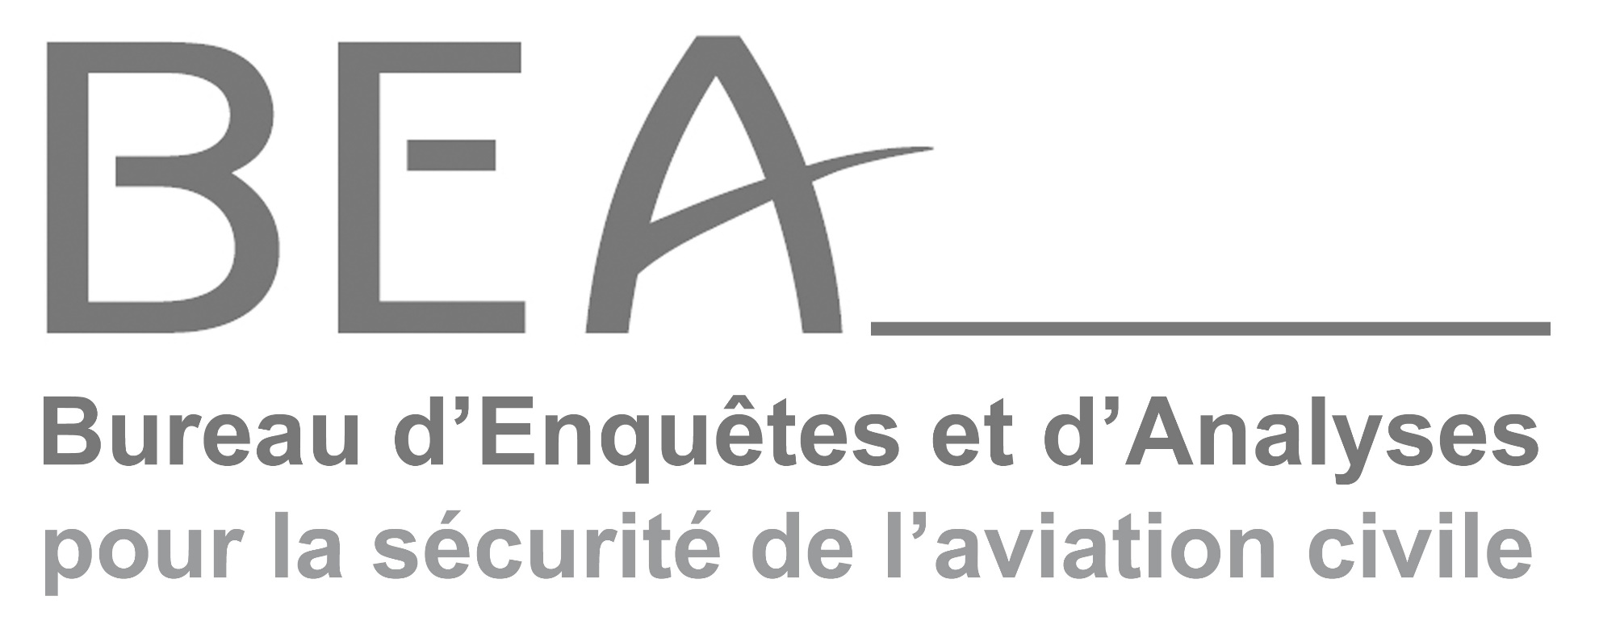
2025 Highlights
Pierre-Yves Huerre
Director

Slide 2
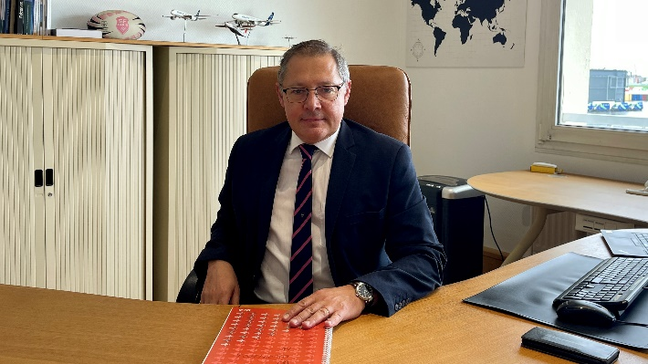
Pierre-Yves Huerre, Director of BEA since 2024
over twenty years' experience within the French Civil Aviation Authority (DGAC).
Head of the North Air Navigation Service between 2008 and 2011 for DSNA.
Deputy Director for Planning and Strategy in Paris for DSNA.
Director of the West DSAC between 2015 and 2018.
Head of the Light and General Aviation & Helicopters Dept since 2018, reporting to the Director General of the DGAC.
Pierre-Yves Huerre, General Engineer is appointed Director of the French civil aviation safety investigation authority (BEA), for a period of five years, starting 01/01/2024.

Slide 3






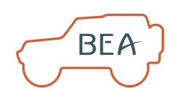
2025 Investigations Overview
71 investigation reports published by BEA
68 investigations opened by BEA
12 safety recommendations issued by BEA
51
accidents
compared with 80 in 2024
11
Serious incidents compared with 10 in 2024
6
Incidents
compared with 5 in 2024
28 go-teams
dispatched
257 foreign investigations opened for which the BEA received official notification

Slide 4
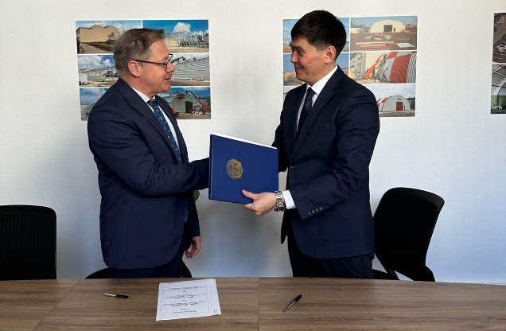
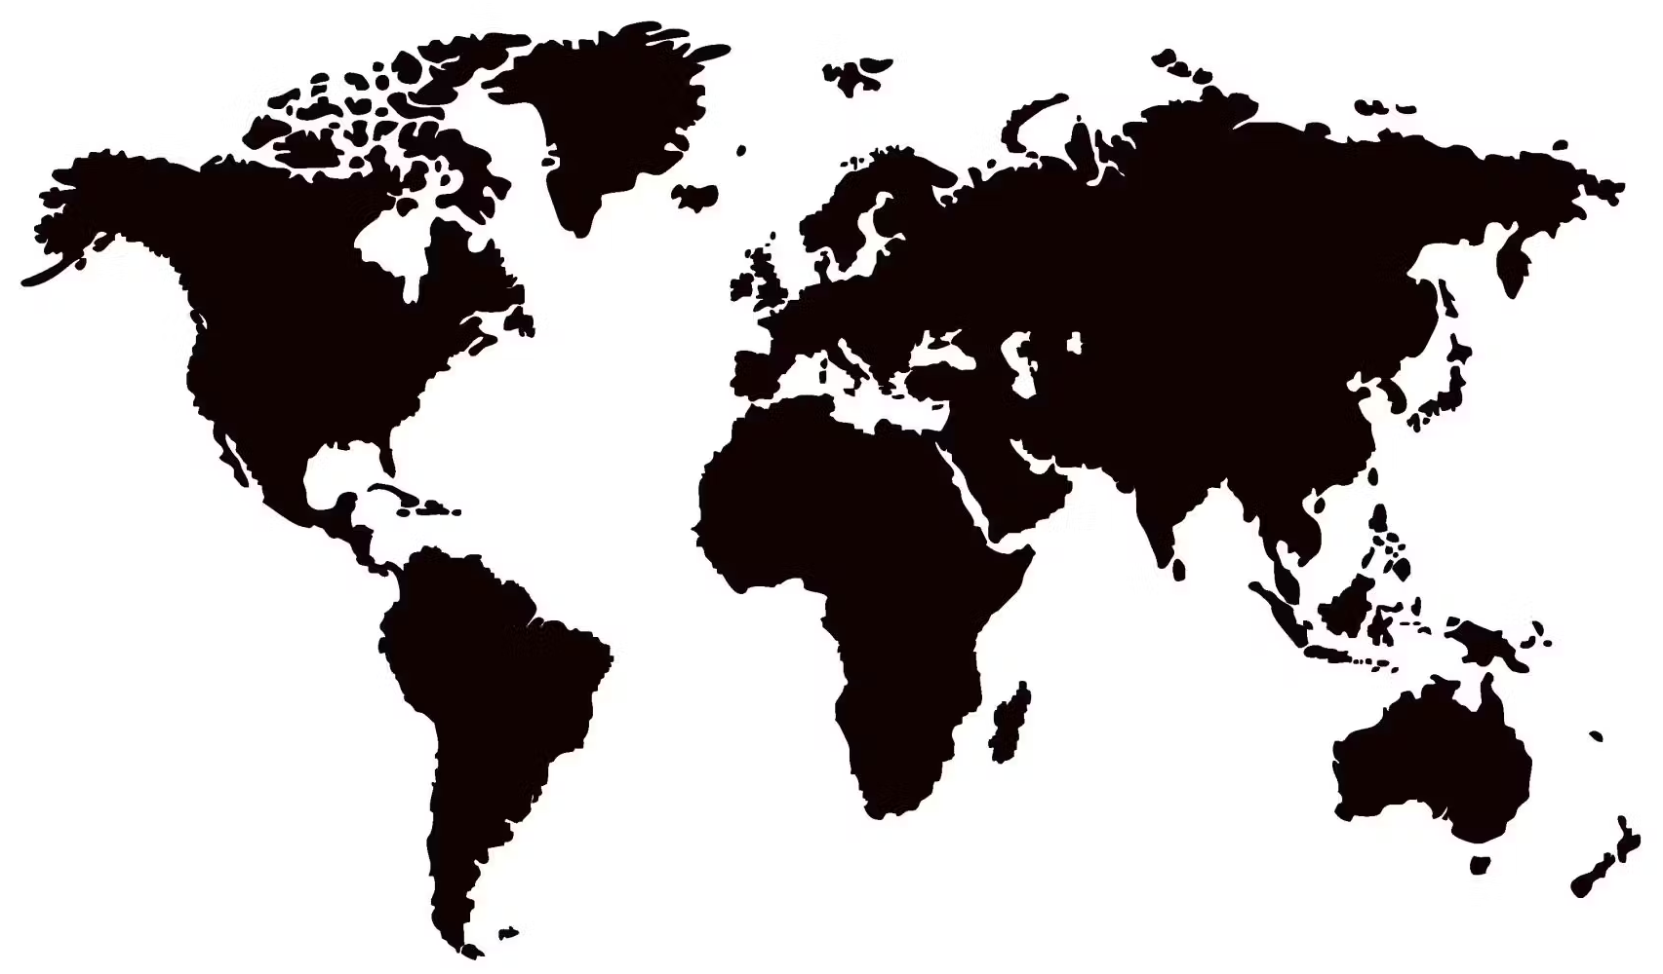
2025 International Activities
The BEA has signed three new cooperation agreements with foreign investigation authorities, bringing the total to 65 signed agreements.
Ten investigators from foreign countries and eight industry investigators attended the BEA advanced commercial air transport accident investigation training course.

Slide 5

2025 Highlights
3 serious incidents:
  Near collision at Nice airport
  Transit over Paris at 2,000 ft due to a mistaken belief that the aircraft was at FL090
  DRAIMS
Delivery of a new computed tomography scanner and scanning electron microscope
ICAO audit: BEA achieves a score of 97,6%

Slide 6
Other means of transport
Marine casualties investigation board
(13 investigations, 11 published reports)
Expected regulatory amendments:
Fatal injury within 30 days of an accident;
Deadline for submitting comments (30 days);
Inclusion of accidents involving fishing vessels <15m;
Protection of information from disclosure for purposes other than the investigation.
Rail-Road-Waterways investigation board
700 events reviewed
9 investigations
13 published reports (7 concerning rail accidents)
Publication of a study on traffic accidents involving submersion in a body of water or a watercourse (available on https://www.bea-tt.developpement-durable.gouv.fr/les-transports-routiers-r27.html)

Slide 7





BEA
10 Rue de Paris
Aéroport du Bourget
93350 LE BOURGET
FRANCE

